Slide 1










Table of
Contents
Academic
Portal
System
Presented by: Group 01
Notes:
https://www.freepik.com/free-ai-image/photorealistic-timber-house-interior-with-wooden-decor-furnishings_152371631.htm

Slide 2







Table of
Contents
Presented by: Group 01
Notes:
https://www.freepik.com/free-ai-image/photorealistic-timber-house-interior-with-wooden-decor-furnishings_152371631.htm

Slide 3
Introduction

Slide 4
Introduction
Why this Project?
1
Manual record-keeping
Our Solution
Attendance, marks, and CGPA tracked on paper or scattered spreadsheets are slow and error-prone.
A single role-based C program that gives Faculty and Students their own portal. It is built on structs, file handling, and simple automation.
2
No single access point
Students and faculty need separate, well-defined ways to reach the data relevant to them.
3
Repetitive calculations
Grades, CGPA, and attendance percentages are hand-calculated every time can be easy to get wrong.

Slide 5
System
Features

Slide 6












System Features
Faculty Portal
Student Portal
Verified by ID lookup in facultyDB
Verified by ID lookup in stdDB
Add Student
Update/Delete
Find and Show
Your Records
Study Timer
Set a timer that alerts when time is up
After logging in with Student ID, the system displays student’s records.
SGPA Calculator
Calculate SGPA & automatically updates CGPA
Attendance
Marks Input
Add Quiz
Quiz
Goal Tracker
Attend teacher assigned quizzes
Compare current CGPA vs target and show the gap

Slide 7
Technical
Design

Slide 8
Technical Design
Data Structures and Files
STRUCTURES
Grade Update
struct Student
assignGrade()
int id, semester, attendance;
float marks, cgpa;
char name[50], dept[20], grade[3];
Uses a pointer and switch to check and update the letter grade of every student.
Attendance (%)
struct Quiz
present_days × 100 / total_classes
(Total Class stored in classCount.txt)
char question[200];
char optA[100], optB[100];
char optC[100], optD[100];
char correct;
CGPA Update
cgpa()
newCGPA = (oldCGPA × (sem−1) + newSGPA) / sem
then semester++
DATA STORAGE
stdDB.txt
All student records such as id, name, dept, marks, grade, CGPA
classCount.txt
Running total of classes held, used for attendance %
facultyDB.txt
Faculty IDs, names, and departments used to verify login
quiz.txt
Quiz questions, four options, and the correct answer

Slide 9
Implementing

Slide 10
Implementing
Language, Libraries & Techniques
Standard Libraries
Core Constructs
File Handling
stdio.h, string.h, stdlib.h, ctype.h, windows.h
structs, functions, switch-case menus, do-while validation
fopen / fscanf / fprintf for persistent storage across runs
Important Implementation Notes
▸ Windows-specific: uses <windows.h> for Sleep() and system("cls")
▸ All menus use do-while validation loops to reject invalid choices
▸ After most operations the user is prompted Y/N to return to the parent menu
▸ Quiz scoring adds the number of correct answers directly to the student’s marks field
▸ Bubble sort is used for ID ordering and for marks-descending display

Slide 11
Demo

Slide 12
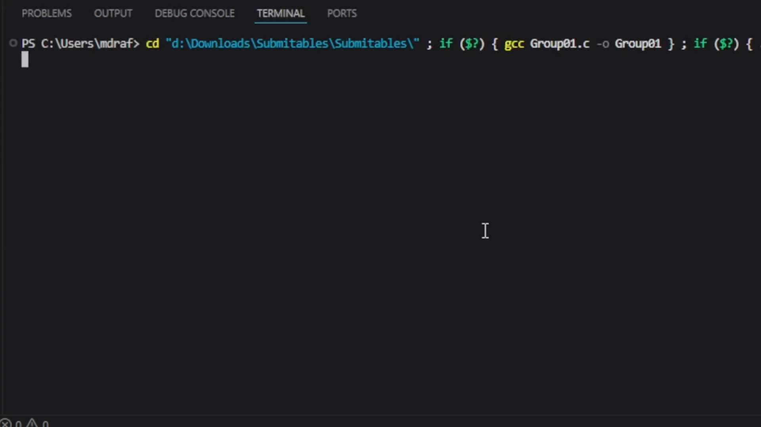
Demo
Features Demo

Slide 13
Reflections

Slide 14

Reflections
Limitations
Future Scope
• Windows-only Sleep, system("cls")
• Cross-platform compatibility
• No password protection; only ID match
• Password hashing and role permissions
• Names cannot contain spaces in name (scanf %s)
• Full-name support with fgets
• No concurrent users
• Separate course-wise records for multiple teachers
• No multi-teacher / multi-class support
• Move from a console menu to a GUI
• Bubble sorting is slow as it is O(n²)
• Export reports or records to PDF
• No input validation for marks range
• Database backend with SQLite

Slide 15
Our Group

Slide 16
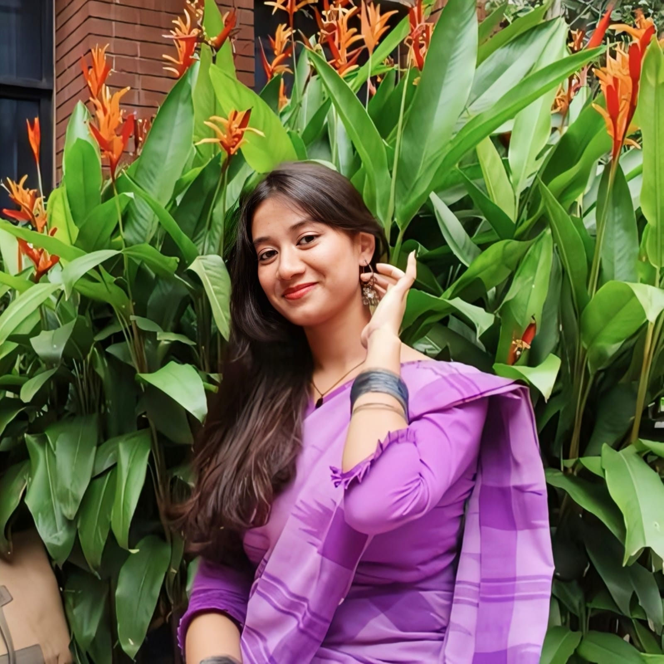
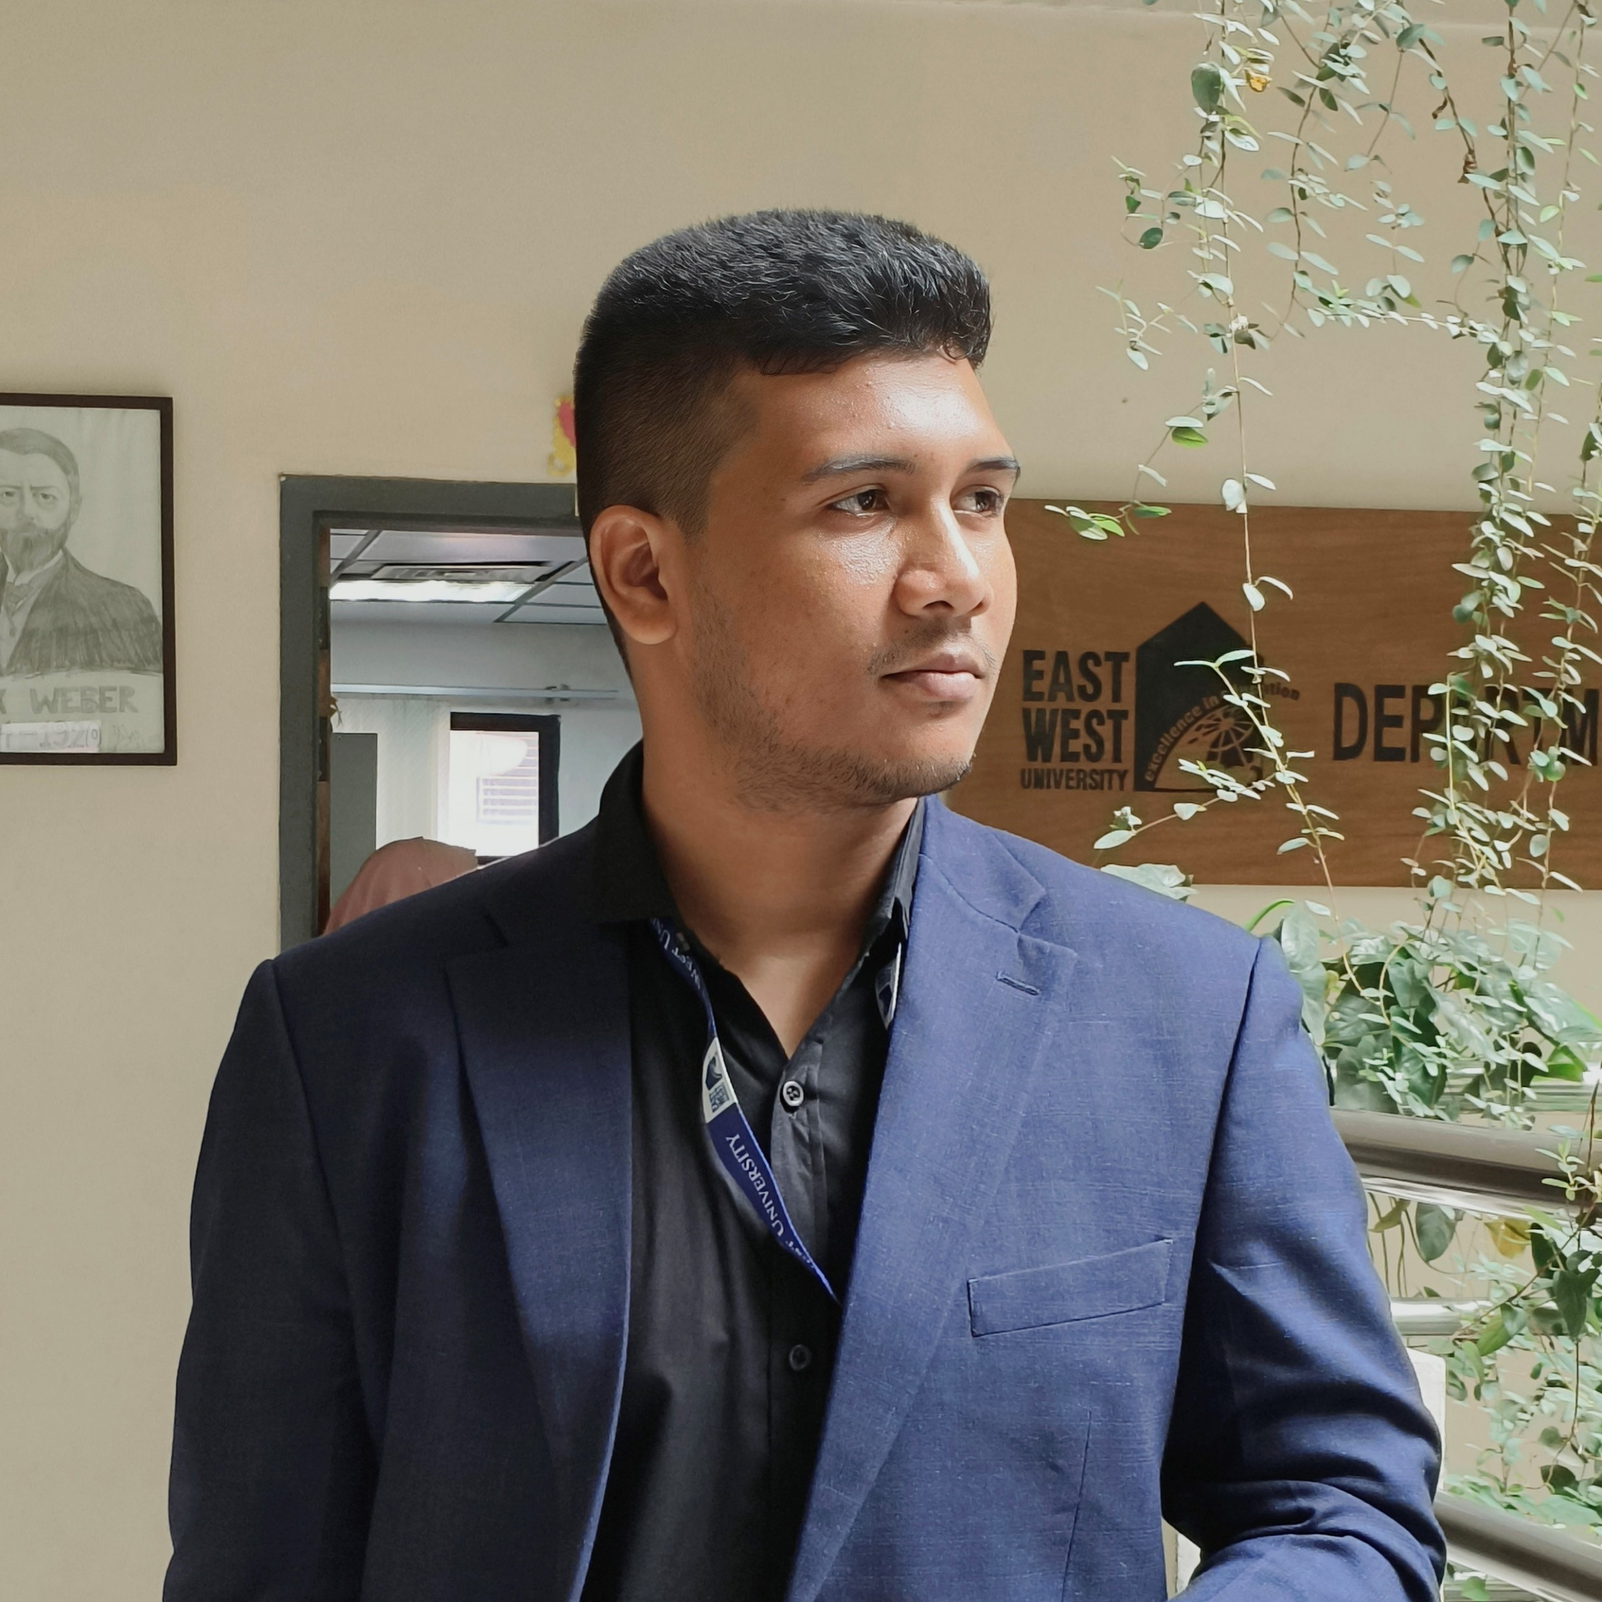
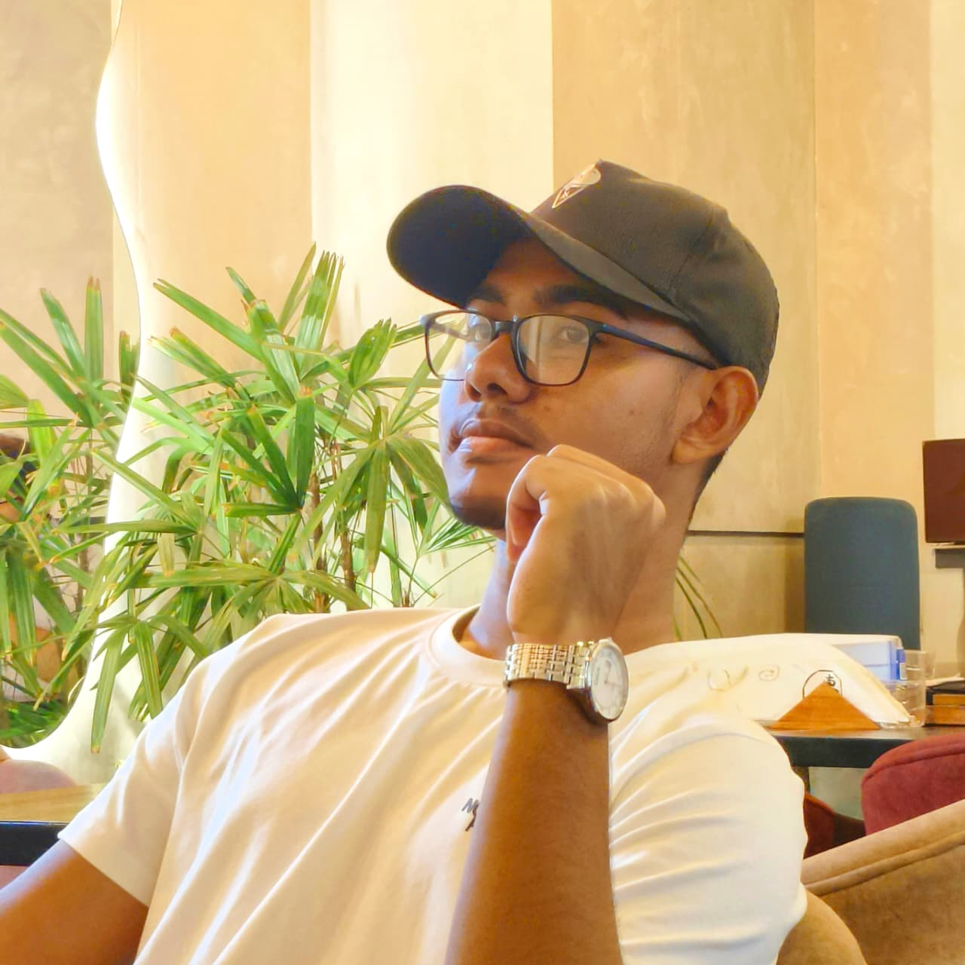
Our Group
Group 01
Department of Computer Science & Engineering
Department of Computer Science & Engineering
Department of Computer Science & Engineering
Maliha Farzana
ID: 2026-2-60-214
Md. Rafsan Janee
ID: 2026-2-60-169
Tanvir Mahdin Haque
ID: 2026-2-60-220

Slide 17

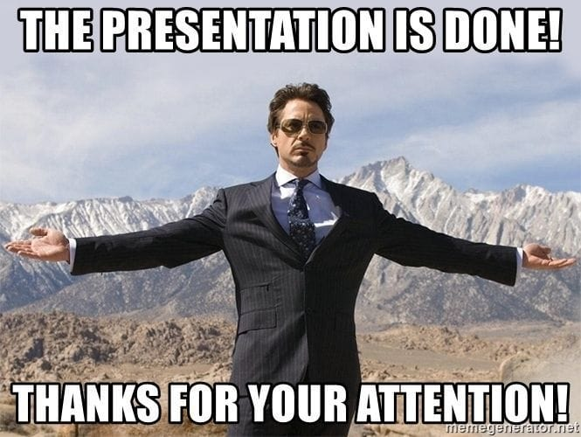

Something on our behalf
Department of Computer Science & Engineering
Department of Computer Science & Engineering
Department of Computer Science & Engineering
Maliha Farzana
ID: 2026-2-60-214
Md. Rafsan Janee
ID: 2026-2-60-169
Tanvir Mahdin Haque
ID: 2026-2-60-220

